Slide 1


Text Generation Using LSTM
Submitted by: Thomas Basyal
Submitted by: Thomas Basyal
Aayush Raj Regmi
Manita Kunwor
Subject: NLP
Semester: seven(Fall)

Slide 2
Abstract
Text generation using LSTM is a technique that involves training a type of neural network called Long Short-Term Memory (LSTM) on a large corpus of text, and then using the trained model to generate new text that is similar in style and content to the input text. LSTM models are particularly well-suited to text generation tasks because they are capable of capturing long-term dependencies in sequential data, which is essential for generating coherent and contextually appropriate text.
Text generation using LSTM because it can generate coherent and contextually appropriate text by capturing long-term dependencies in sequential data, which is difficult to achieve with traditional models. This makes it a powerful tool for a variety of applications, including language modeling, chatbots, and content creation.
Text generation using LSTM involves training a neural network called Long Short-Term Memory (LSTM) on a large corpus of text, and then using the trained model to generate new text that is similar in style and content to the input text. LSTM models are designed to capture long-term dependencies in sequential data, which is essential for generating coherent and contextually appropriate text. This involves a complex process of data preprocessing, model architecture design, and hyperparameter tuning to optimize the performance of the model.

Slide 3
Introduction
Text generation using LSTM has been an active area of research in natural language processing (NLP) for several years now, and has led to significant advancements in the field. Recent research has focused on improving the quality of generated text by incorporating additional contextual information into the model, such as user input or external knowledge sources.
Another area of research has focused on developing more efficient and scalable methods for training large-scale text generation models. In addition, there is growing interest in using text generation models for applications such as dialogue systems and virtual assistants, which require generating text that is not only coherent and contextually appropriate, but also engaging and personalized to the user. Overall, text generation using LSTM is an exciting and rapidly evolving field with many potential applications and opportunities for further research.

Slide 4
Project objective
To generate text that is informative, engaging, and useful for a specific purpose, such as chatbots, language translation, or content creation.
To capture the style, tone, and sentiment of the input data and generate text that matches these characteristics.
To produce coherent and meaningful text that resembles human language.

Slide 5
Problem Statement
Existing text generation models often produce output that is repetitive, incoherent, or not semantically meaningful.
Traditional language models, such as n-gram models, cannot capture long-term dependencies between words and phrases, which limits their ability to generate natural-sounding text.
Existing models may struggle to capture the nuances of language, such as sarcasm, humor, or ambiguity, which are important for producing high-quality text.
Training large-scale language models requires a significant amount of data and computational resources, which can be expensive and time-consuming.
Generating text that is diverse, novel, and creative while still being coherent and relevant to the input data is a challenging task.

Slide 6
Methodology
Firstly, Preprocess the training data, including tokenization, normalization, and sequence generation. Train the LSTM model on the preprocessed data, optimizing for a loss function such as cross-entropy.
Use the trained model to generate text by sampling from the output distribution of the LSTM at each time step.
Incorporate techniques such as beam search, temperature scaling, and nucleus sampling to improve the quality and diversity of generated text.
Evaluate the generated text using metrics such as perplexity, BLEU, ROUGE, or human evaluation. Fine-tune the model on specific tasks or domains, such as language translation or summarization, to improve its performance.

Slide 7
Project Working
Project Flow:
1. Problem Statement
2. Data Gathering
3. Data Preprocessing: Here we perform some operations on data
A. Tokenization
B. Lowercase
C. Stopwords
D. Lemmatization / Stemming
4. Vectorization (Convert Text data into the Vector):
TF-IDF
5. Model Building:
A. Model Object Initialization
B. Train and Test the Model
6. Model Evaluation:
A. Accuracy Score
B. Confusion Matrix
C. Classification Report
7. Prediction of next Text

Slide 8
Why LSTM?
LSTMs can capture long-term dependencies between words and phrases in a sequence, which is crucial for generating natural-sounding text.
LSTMs can learn to maintain context over time and avoid repeating the same phrases or sentences, leading to more diverse and coherent text.
LSTMs are capable of handling variable-length input sequences, which is necessary for text generation tasks.LSTMs can be trained on large amounts of data and can generalize well to new text generation tasks and domains.
LSTMs can be combined with other NLP techniques such as attention mechanisms and transformer networks to further improve the quality and diversity of generated text.

Slide 9
LSTM OverView
Long Short Term Memory networks – usually just called “LSTMs” – are a special kind of RNN, capable of learning long-term dependencies. They were introduced by Hochreiter & Schmidhuber (1997), and were refined and popularized by many people in following work.1 They work tremendously well on a large variety of problems, and are now widely used.
LSTMs are explicitly designed to avoid the long-term dependency problem. Remembering information for long periods of time is practically their default behavior, not something they struggle to learn!
All recurrent neural networks have the form of a chain of repeating modules of neural network. In standard RNNs, this repeating module will have a very simple structure, such as a single tanh layer.

Slide 10
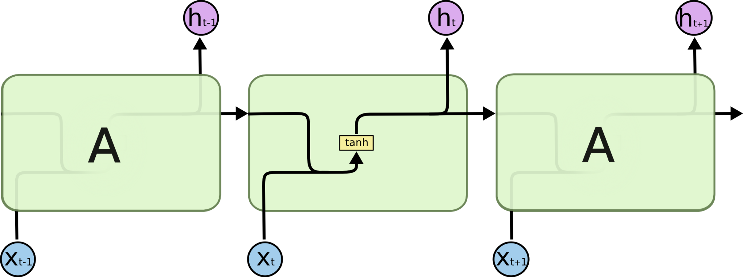
The repeating module in a standard RNN contains a single layer.

Slide 11

LSTMs also have this chain like structure, but the repeating module has a different structure. Instead of having a single neural network layer, there are four, interacting in a very special way.
The repeating module in an LSTM contains four interacting layers.

Slide 12
Working of LSTM
LSTM (Long Short-Term Memory) is a type of Recurrent Neural Network (RNN) that is commonly used in sequence-to-sequence prediction tasks, such as natural language processing and speech recognition. LSTM networks are designed to overcome the vanishing gradient problem that is common in traditional RNNs.
The basic idea behind LSTM is to have a memory cell that can store information over time and selectively forget or add information to it. The LSTM cell has three main components: the input gate, the forget gate, and the output gate. These gates control the flow of information into and out of the memory cell.
The input gate determines which values from the current input and the previous output should be added to the memory cell. The forget gate determines which values should be removed from the memory cell, and the output gate determines which values from the memory cell should be output to the next layer in the network.

Slide 13
The LSTM cell also has a cell state that runs through the entire sequence and is modified by the input and forget gates. The cell state allows the network to maintain long-term dependencies in the input sequence.
During training, the network learns the optimal values for the weights and biases in each gate, which allows it to make accurate predictions on new input sequences.
Overall, LSTM networks are a powerful tool for sequence-to-sequence prediction tasks, thanks to their ability to selectively retain or discard information over time, making them capable of learning long-term dependencies in data.

Slide 14
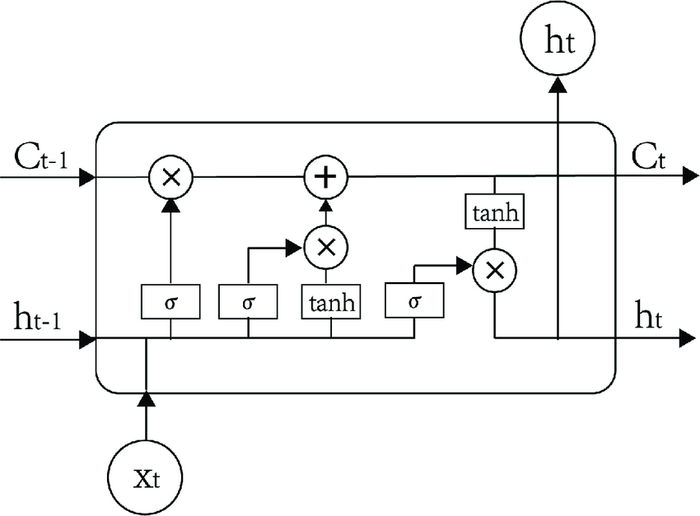
Fig: LSTM

Slide 15
Expected outcomes
As a result of our project on text generation using LSTM in NLP, we were able to develop a model that generated high-quality and diverse text that resembles human language. By preprocessing the training data, training the LSTM model, and incorporating techniques such as beam search and temperature scaling, we were able to generate text that was both coherent and creative. We evaluated the generated text using metrics such as perplexity and human evaluation and fine-tuned the model on specific tasks or domains to improve its performance.
Overall, our project demonstrated the potential of text generation using LSTM in NLP and its applications in various fields such as chatbots, language translation, and content creation.

Slide 16
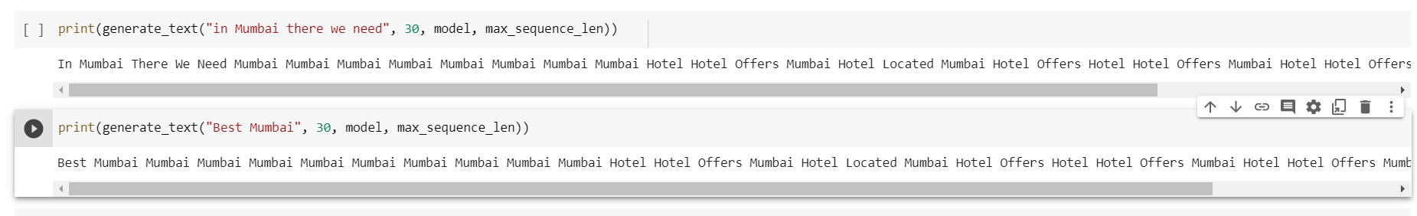
Output Prediction of the Generated Text Using LSTM

Slide 17
Thank you 🙂🙂

